Slide 1
Figure 1: Field collections and experimental design. Unbleached and bleached corals were collected from a reef in Mo’orea, French Polynesia immediately following a bleaching event. Picture on top: the LTER1 fore reef in Mo’orea, French Polynesia representative of the status of the reef where both bleached and unbleached corals were present. A.I-A.V) Overview of the experimental design. In addition to the four treatments two negative controls of ambient and heated water were run in parallel but are not shown in the overview. A.I) Coral nubbin collection of non-bleached and bleached corals. A.II) 6 day pretreatment in flow through aquaria at ambient or heated water temperatures. A.III) DOM exudation (*one replicate aquaria was lost before exudation), A.IV) 36 hour dark bottle incubation, A.V) and sampling of DNA (16S), DOC, and DOM. B) Mean seawater temperatures over the period from January 1st 2018 until December 31st 2019 from three fore reef LTER sites. Standard deviation depicted in blue. The orange line indicates the thermal stress accumulation threshold level of 29°C (Leinbach et al., 2021; Pratchett et al., 2013; Speare et al., 2021). Bleaching was first observed in April 2019 (Leinbach et al., 2021), indicated by the start of the red line, which continued until the temperature levels dropped under the thermal stress accumulation threshold. The experiment, indicated by the purple block, was started immediately after temperatures dipped below the thermal stress accumulation threshold. C) A subset of collected nubbins of the three coral species (Acropora pulchra, Pocillopora verrucosa, Porites rus) were sacrificed after the three day acclimatization period for symbiont cell concentration analysis to validate the observed bleaching status at collection D) Symbiont cell concentrations of the coral nubbins from the different treatments after seven days in the aquaria.

Slide 2
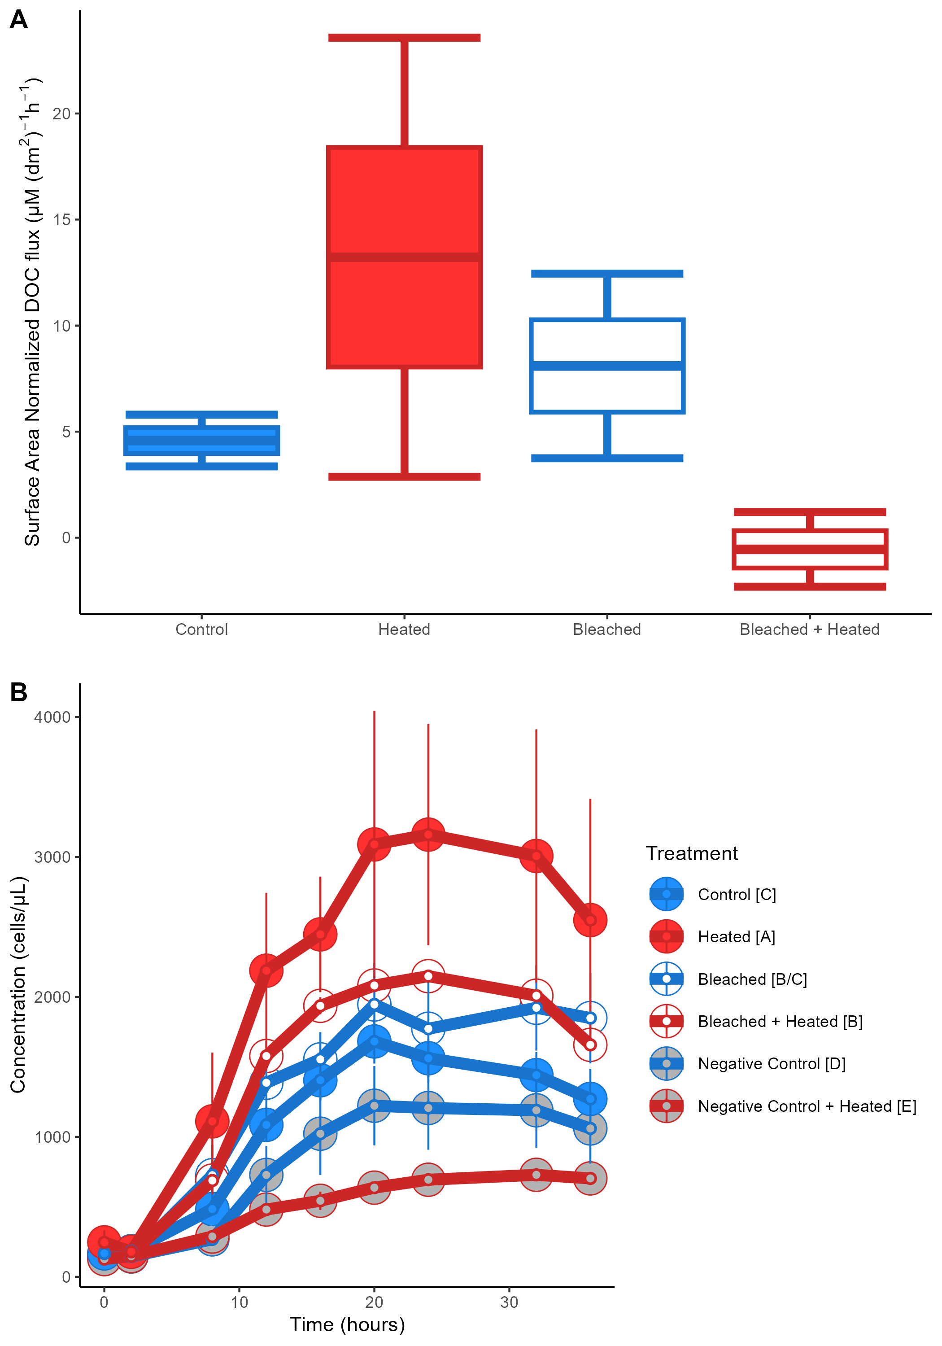
Figure 2: DOC exuded and microbial growth on exudates. A) Box and whisker plots of surface area normalized DOC concentrations for the four coral treatments. B) Bacterial growth curves for the six treatments in the 36 hour bottle incubation, error bars indicate standard error of the mean. Significant differences between treatments (Tukey post-hoc test, p<0.05) are denoted by the square brackets after each treatment name in the legend.

Slide 3


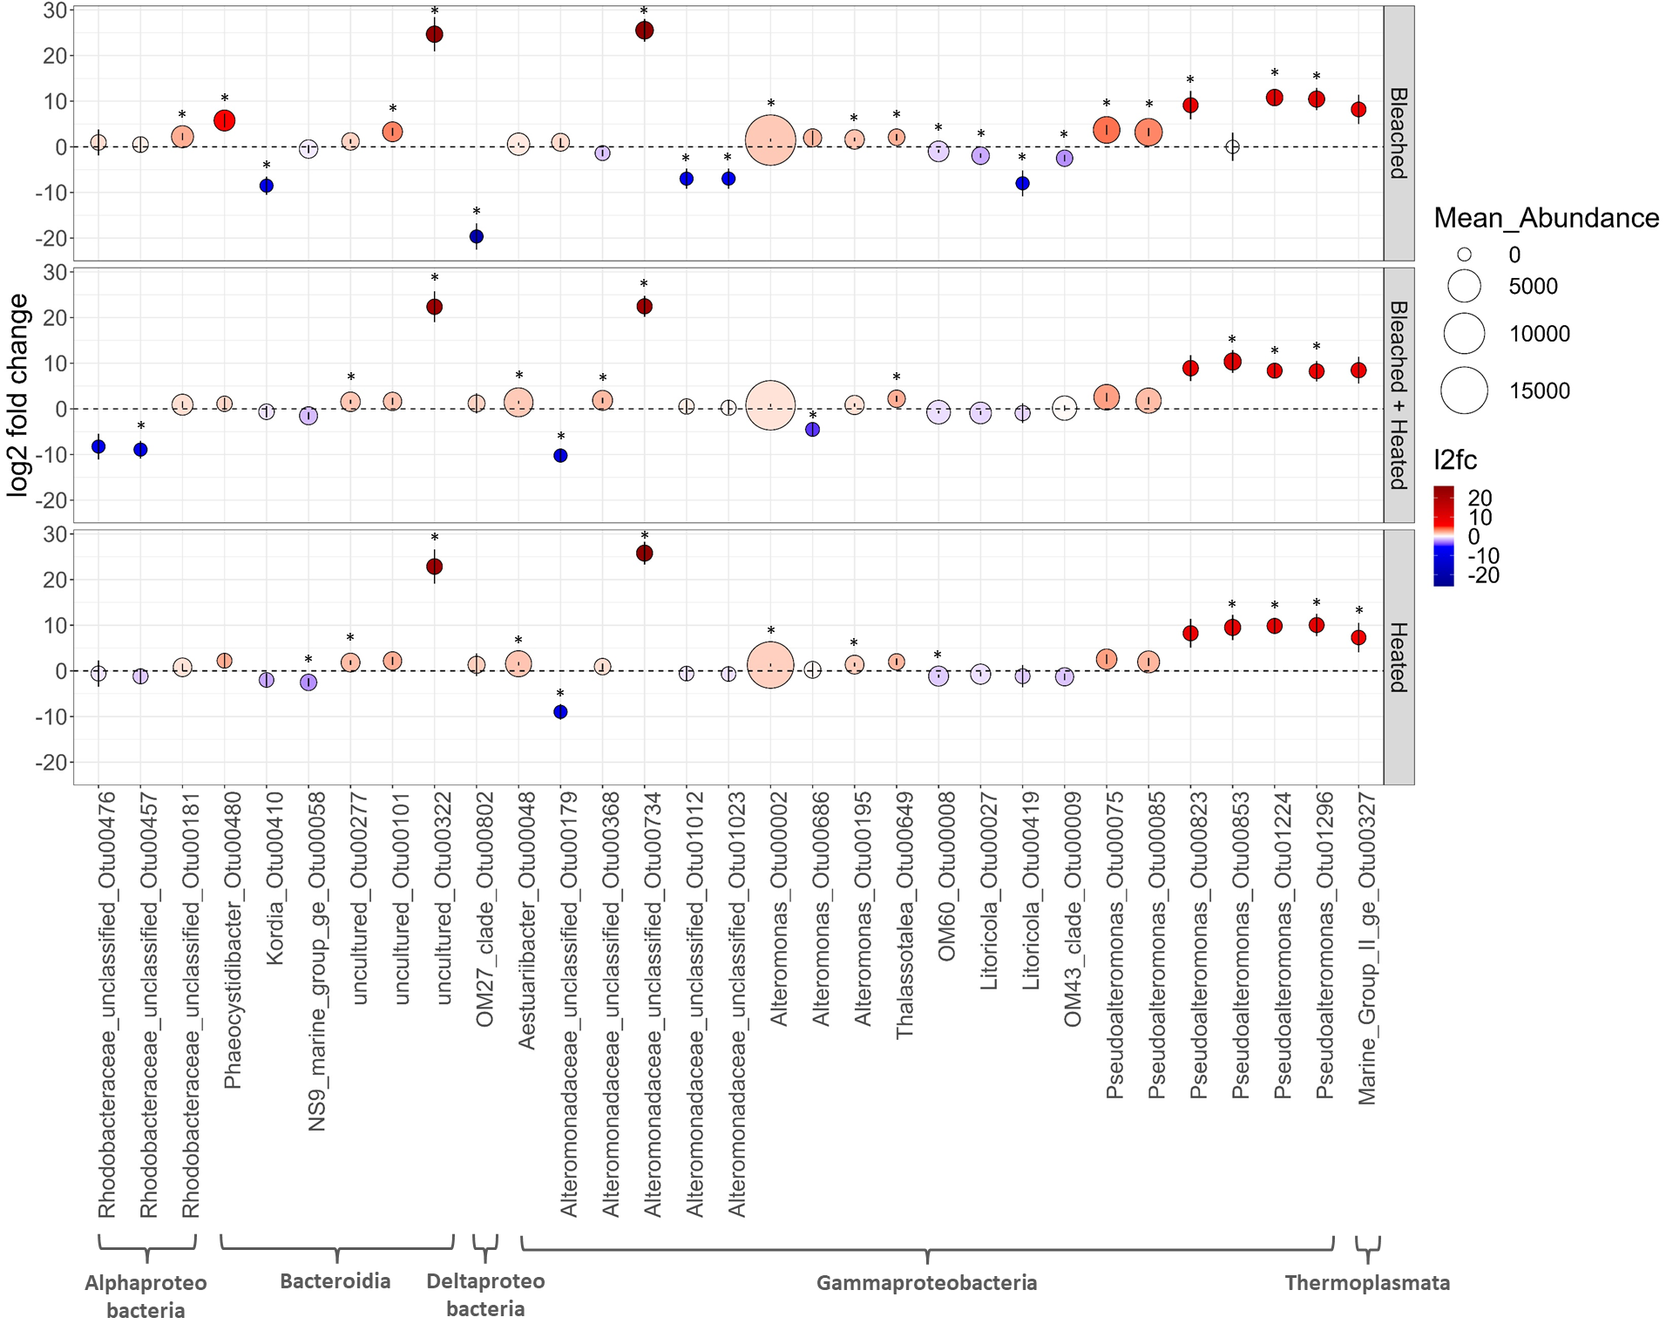
A
B
zscore
C
Figure 3: Changes in microbial communities in response to exudates. A) Non-metric multidimensional scaling of microbial community samples using Unifrac distances derived from 16S amplicon data. A dashed ellipse denotes the 3 coral stress treatments while a solid ellipse denotes the coral Control treatment. B) Two-way heatmap of the most abundant bacterial families in each treatment. Abundant families were defined as: relative abundance ≥ .005 in samples ≥ 3 or a relative abundance ≥ .1 in samples ≥ 1. Each cell represents the z-scored mean relative abundance of a given family in a treatment. Cells are colored according to z-score, with warmer colors indicating enrichment and cooler colors indicating depletion. Clustering was performed using Euclidian distances. C) Visualization of the 31 OTUs determined to be significantly differentially abudant (DA) in at least one of the three stress treatments compared to Control samples by DESeq2. Dotplot of the log2 fold-change values for the 31 significantly DA OTUs in the three coral stress treatments. Each dot represents a given OTU in a given treatment. Dot height on the y-axis and color correspond to log2 fold-change values. Error bars depict the standard error of each log2 fold-change value calculated by DESeq2. Dot size corresponds to mean raw abundance. Each OTU is labeled according to its class, family, and Genus_OTUNumber on the x-axis. Asterisks denote a significantly DA OTU in a treatment.

Slide 4

Figure 4: Compositional differentiation of coral exudates (as measured by untargeted tandem mass spectrometry) and correspondence with composition of microbial communities grown on exudates. A) Non-metric multidimensional scaling plot of t0 metabolomic samples using bray curtis dissimilarity. A dashed ellipse denotes the 3 coral stress treatments while a solid ellipse denotes the coral Control treatment. B) Procrustes visualization of multivariate metabolomic and microbial samples. Arrows point from microbial samples to corresponding metabolomic samples.

Slide 5
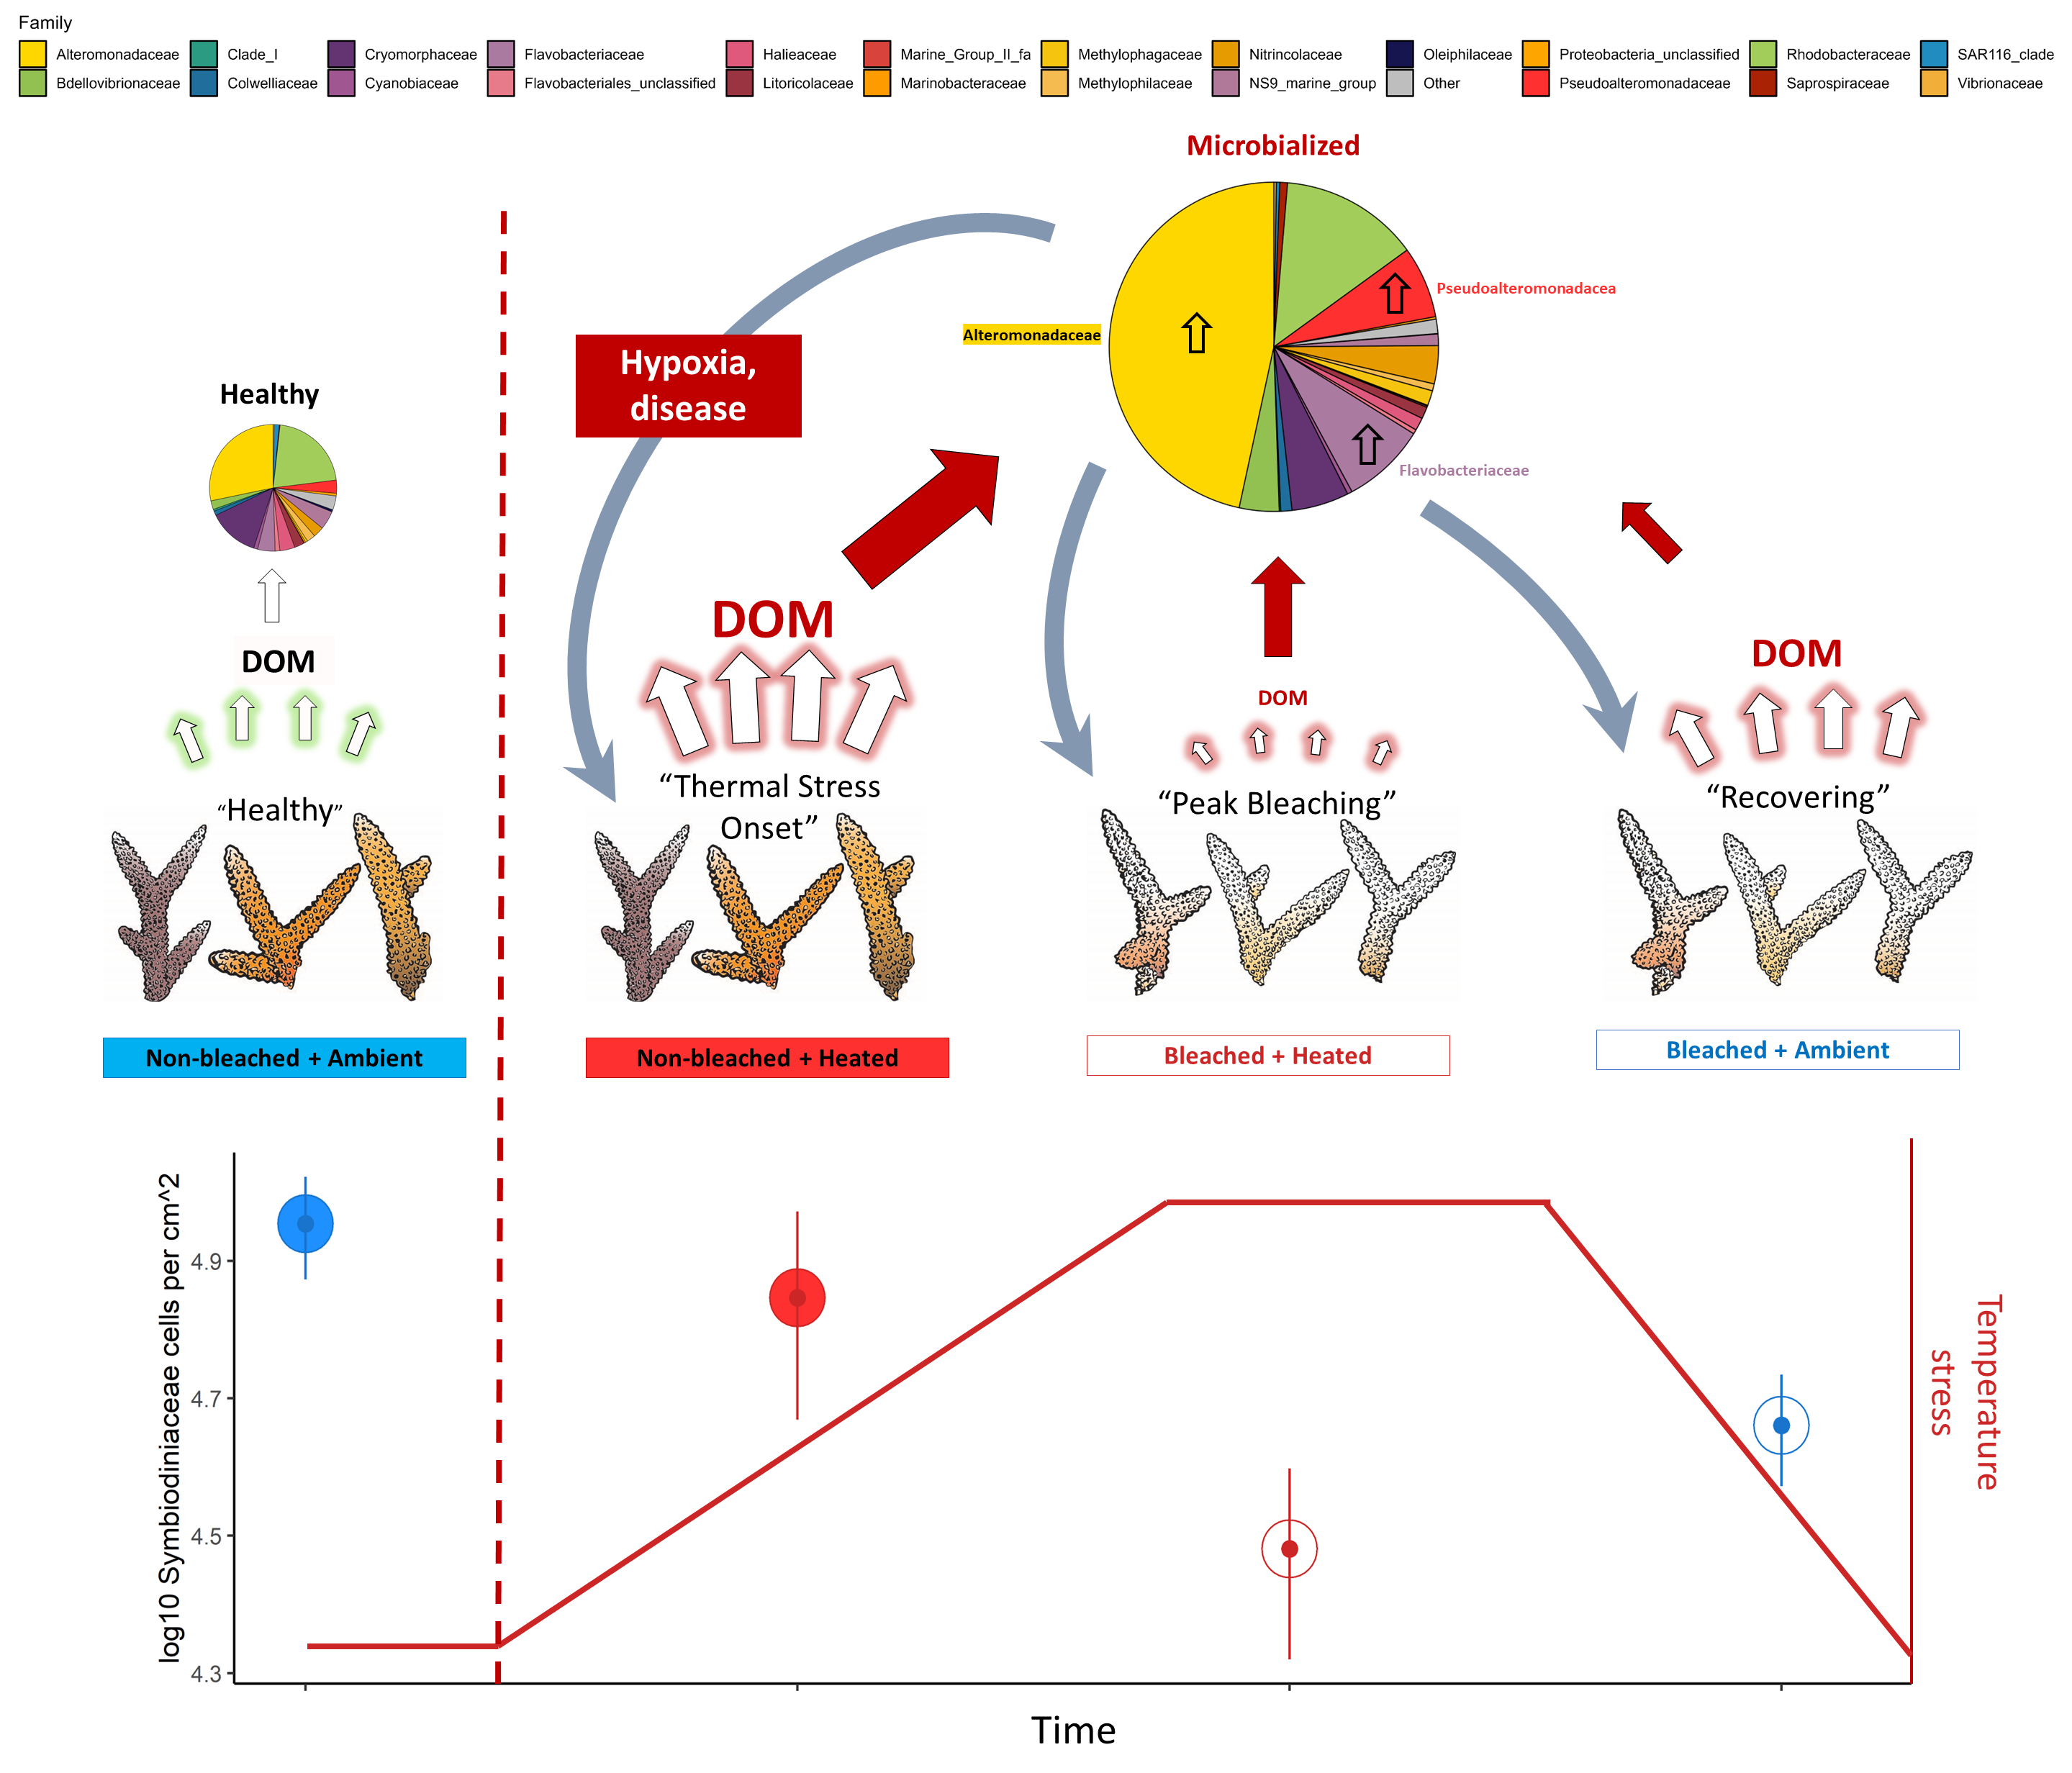
Figure 5: Conceptual representation of biogeochemical changes during a coral bleaching event. Bleaching progresses from left to right, with SST values increasing until their peak and then return to ambient values. Corals experience a change in physiological state and symbiont densities through the thermal anomaly, going from “Healthy” to “Thermal Stress Onset” to “Peak Bleaching” and lastly, “Recovering”. The associated treatment names from our experiment are written below the corals. Symbiont densities for each treatment are plotted with temperature, with densities decreasing through “Peak Bleaching” and then increasing slightly in “Recovering.” Densities were derived from data presented in Figure 1D. DOM flux is highest at “Thermal Stress Onset”, indicated by the size of the arrows pointing from corals to “DOM”. In all 3 of the stressed treatments, bacterioplankton communities shift towards a “microbialized” state marked by increased cell counts (indicated by the size of the arrow pointing towards the pie chart) and a greater relative abundance of copiotrophs and pathogens, namely in the Alteromonadaceae, Pseudoalteromonadaceae, and Flavobacteriaceae families. We propose that these microbialized communities derived from stressed coral DOM exudates further harm the corals via hypoxia from increased bacterial loads and disease from the uptick in bacterial pathogens. The state of microbialization is most pronounced at the onset of thermal stress, may push corals towards more severe bleaching and ultimately, mortality.

